Slide 1
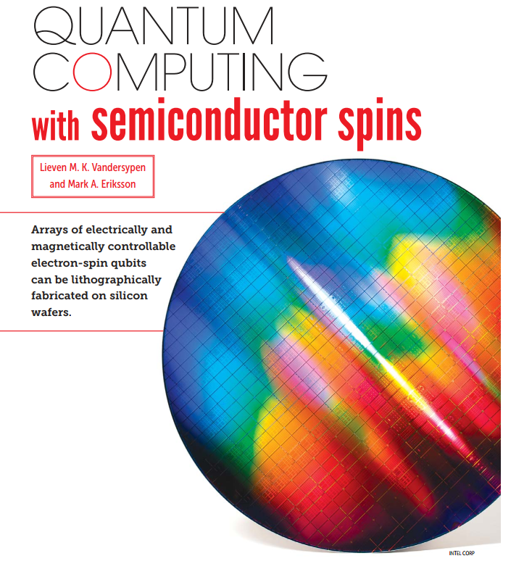
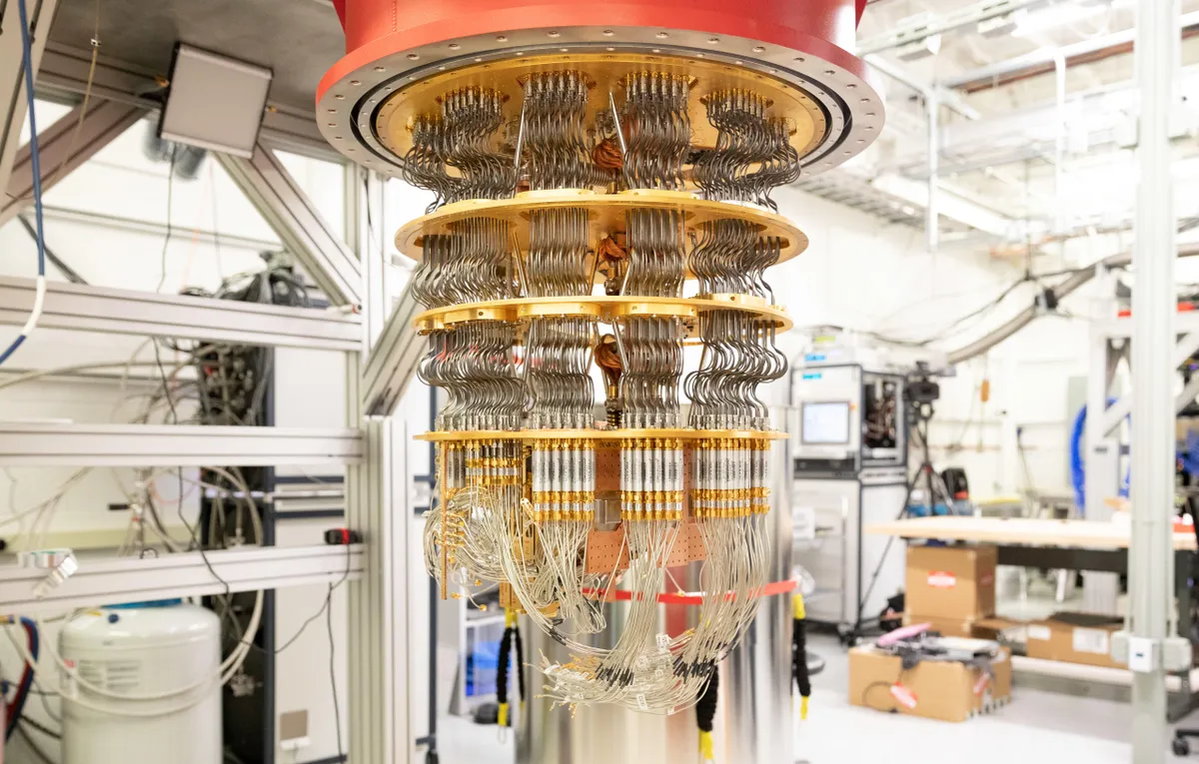
Quantum computing with semiconductor spins
Lieven M. K. Vandersypen and Mark A. Eriksson
Physics Today 72, 38-45 (2019) https://doi.org/10.1063/PT.3.4270

Slide 2
Outline
Introduction
Quantum dot (QD) from transistor
Fabrication of Ga-As gate defined QD
Theory of Bloch’s sphere, Rabi oscillations, and a general single qubit gate
Initialization, read-out, manipulation of QD, and the CNOT gate
Relaxation, decoherence, and advantages of Si
Quantum search algorithm, types of QD, scaling challenges faced currently
Addressing the challenges

Slide 3
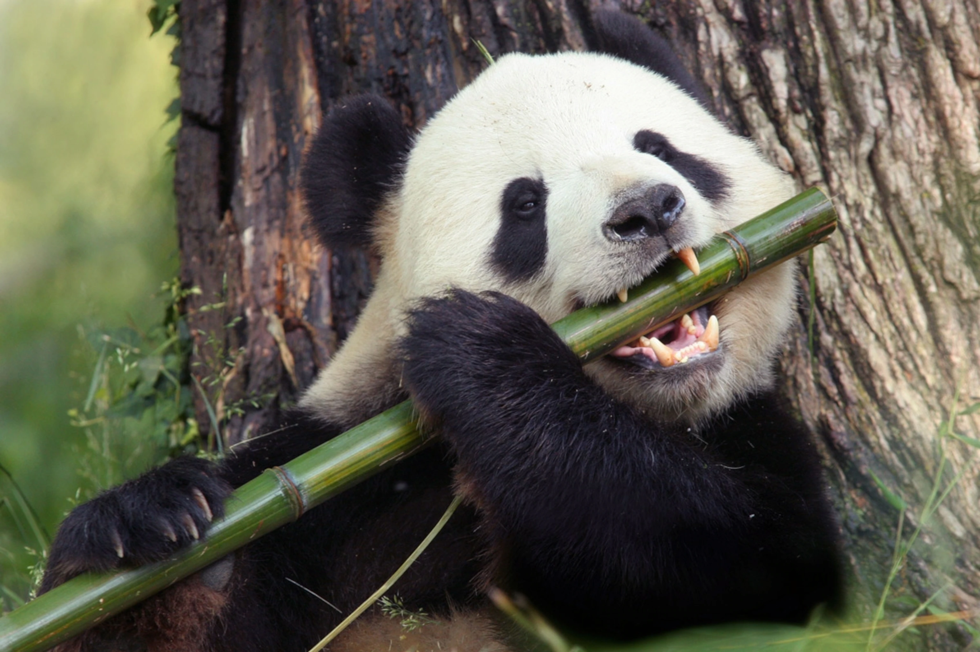

Why need a quantum computer?
Dealing with classically intractable problems. (Problem specific)
Specially escape and encryption based problems (Combinatorics).
Conditionals

Slide 4
Classical computer
Binary signals are measured in bits.
It’s a single unit of information that has a value of either 0 or 1 (off or on, false or true, low or high).
Similar as low and high resistive state.
More complicated the code, more processing power is required and longer it takes to reach the computational objective.
Where do classical computer struggle?
Combinatorics → Finding arrangement of items that optimize some goals.
So, as the no.of items grow, no.of combinations grow exponentially.
To find solution classical computer has to iterate through each permutation to find an optimal solution.

Slide 5
Quantum computer
Atomic states to run computation.
Data is held in qubits.
Qubit: Two level quantum system!
Eg: Spin in magnetic field or a photon. (0&1 will be the spin states)
In quantum world the qubit doesn’t need to be in 0 or 1 state. It can be in any proportions of both the states → SUPERPOSITION.
Until the measurement is done the qubit is in superposition of probabilities of 0’s and 1’s. The instant we measure it collapses into one of the definite states.
Superposition of states make the difference.
2^(no.of qubits) = no.of classical bits
Recently Google’s quantum computer solved a complex problem in 4 mins which would require 10,000 years in our best classical computer available.
Quantum computing addresses 5 domains in total: AI (QML), Drug discovery, Cyber security, Complex manufacturing, Financial services.

Slide 6
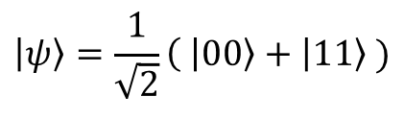
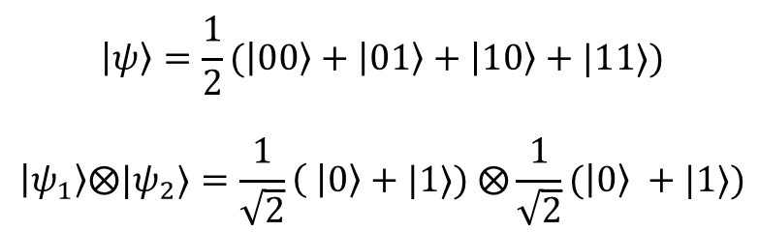
Superpowers of quantum computer : (i) Superposition (ii) Entanglement
(i) Superposition:
A 4 bit information will have 2^4 possible combinations.
Classical computer will require 16 bits to store all possible combinations. Whereas a quantum computer can store all the information in just 4 qubits.
Eg : Imagine a 100 bit information in a quantum computer will require just 100 qubits, but in a classical computer it requires 1.2676506 x 10^30 bits!!!
(ii) Entanglement:
Data held in qubits effect the data held in other qubits no matter how far they are apart. (i.e. measuring each qubit will deduce the properties of other qubit without having a look)

Slide 7
Di Vincenzo's criteria
🛆 E2 >> KbT
Initialization → Initial state should be ground state
Read out → Large decoherence time
Universal logic gates → Computation algorithms (single & two qubit manipulation)
Scalability

Slide 8
Key challenge
Stabilizing an electron inside a semiconductor, avoiding it getting decohered in a noisy environment.
Typical size of a quantum dot is 20 nm x 20 nm. (Fabrication challenge)
Minimum disorder with easier positioning and control of electrons.

Slide 9
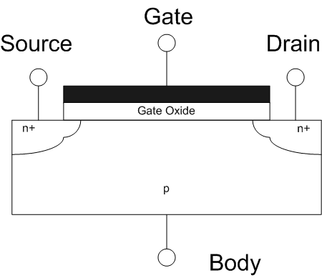
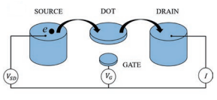
From Transistor to Qubit
Field Effect Transistor(FET) :-
Single Electron Transistor(SET):-

Slide 10
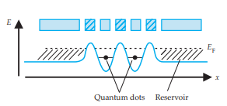
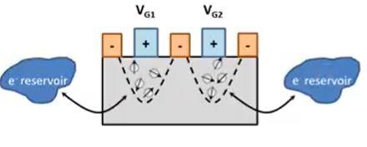
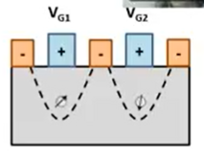
.
Gate Defined Quantum Dots :
Different electrodes shape the potential landscape of the channel.
Process:-

Slide 11
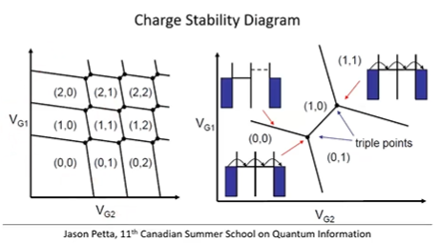
.
Charge stability:-

Slide 12
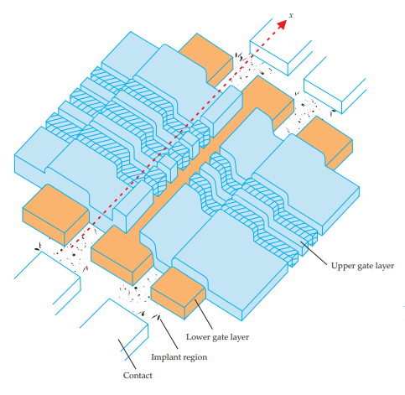
.
The Schematic of two tunnel coupled quantum dots:
Voltages applied to upper gate layer shape the potential landscape
Voltages applied to lower gate layer delimits the channel

Slide 13
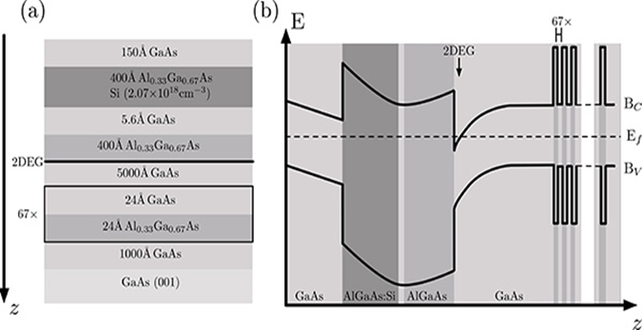
Motivation and Heterostructure Design
Advantages of GaAs
Significance of AlGaAs/GaAs 2D electron gas
Bureau-Oxton, C., Camirand Lemyre, J., Pioro-Ladrière, M. Nanofabrication of Gate-defined GaAs/AlGaAs Lateral Quantum Dots. J. Vis.Exp. (81), e50581, doi:10.3791/50581 (2013).https://doi.org/10.3791/50581

Slide 14
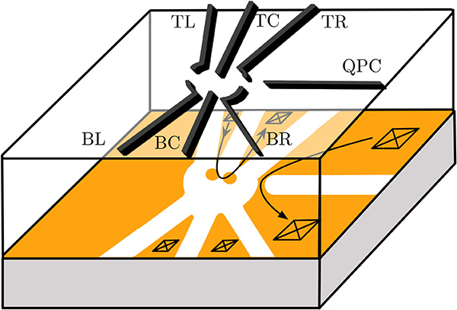
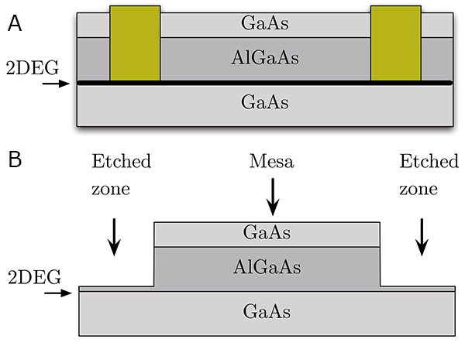
Device Structure
Bureau-Oxton, C., Camirand Lemyre, J., Pioro-Ladrière, M. Nanofabrication of Gate-defined GaAs/AlGaAs Lateral Quantum Dots. J. Vis. Exp. (81), e50581, doi:10.3791/50581 (2013). https://doi.org/10.3791/50581

Slide 15
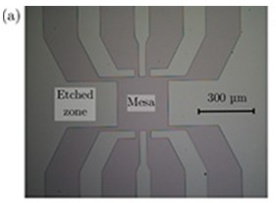
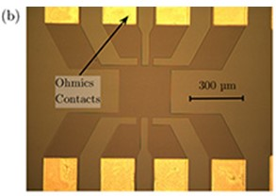
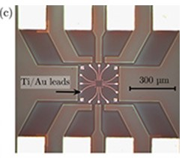
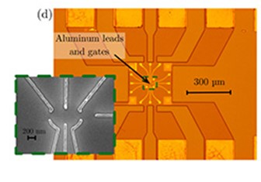
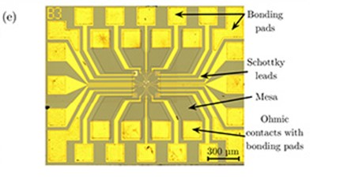
Fabrication procedure
Bureau-Oxton, C., Camirand Lemyre, J., Pioro-Ladrière, M. Nanofabrication of Gate-defined GaAs/AlGaAs Lateral Quantum Dots. J. Vis. Exp. (81), e50581, doi:10.3791/50581 (2013). https://doi.org/10.3791/50581

Slide 16
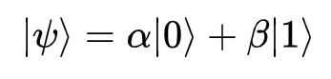
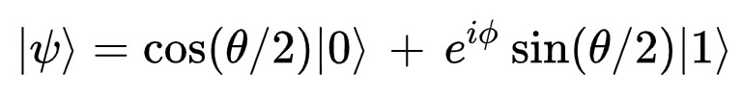
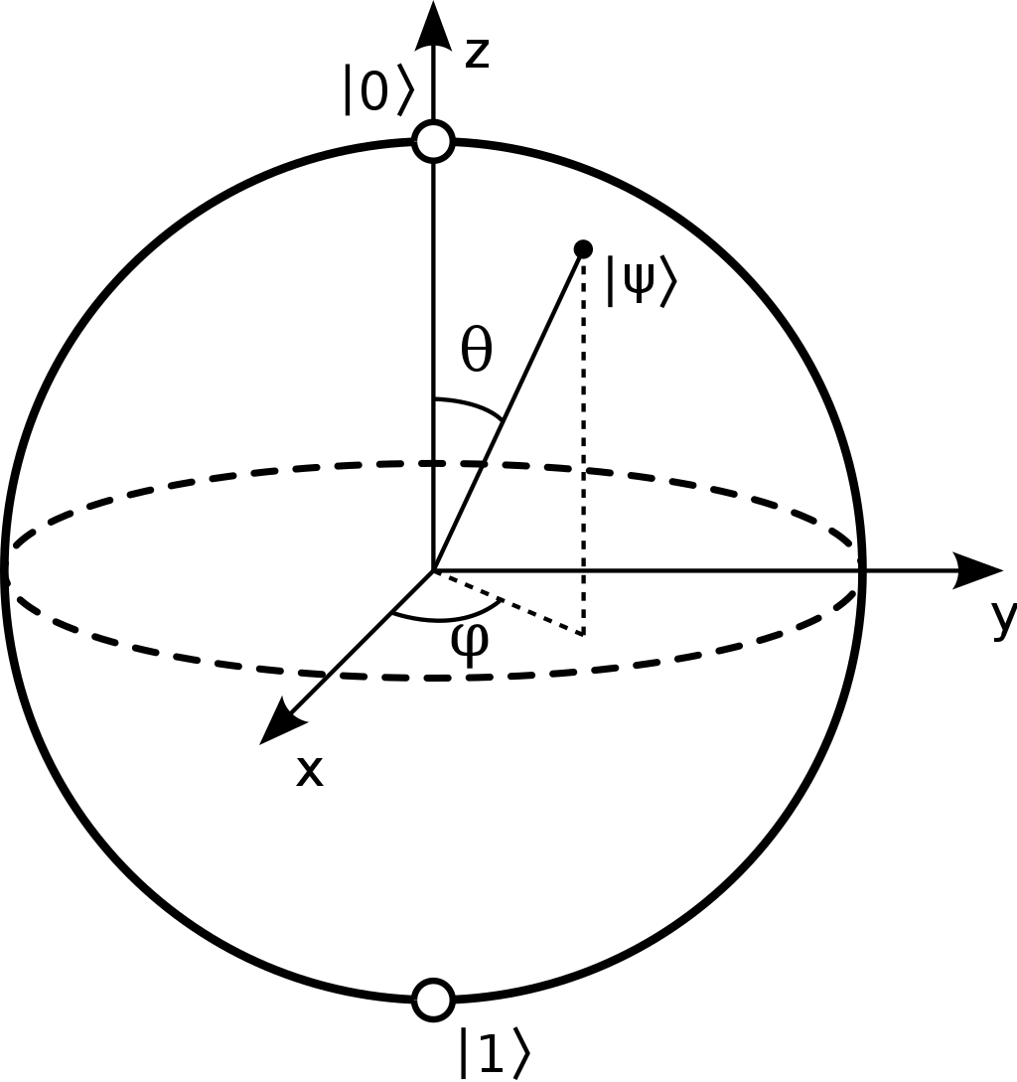
Qubit and Bloch Sphere
What is a Qubit?
In quantum computing, qubit is the basic unit of quantum information.
A qubit is implemented using a two-level quantum system.
Any possible spin state of an electron can be represented by the points on the surface of Bloch Sphere.

Slide 17
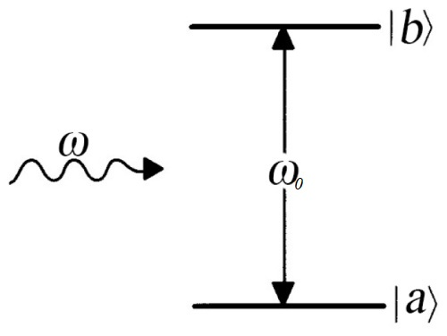

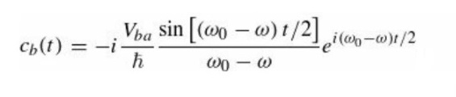
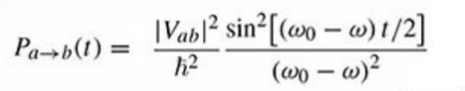
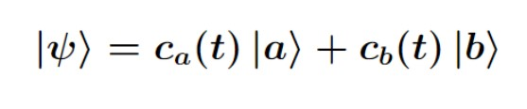
Rabi Oscillations
We apply a perturbation of the form:
where V(r) is the dipole energy
Using Time Dependent Perturbation Theory,

Slide 18
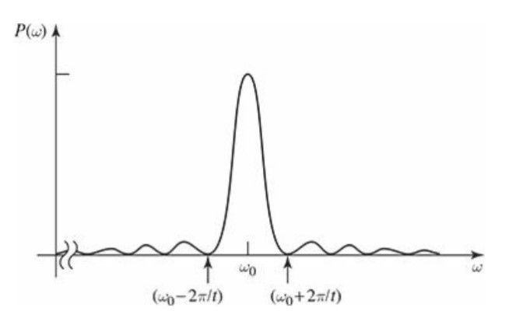
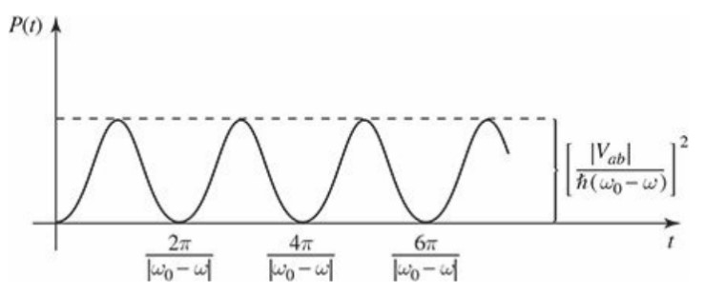

Slide 19
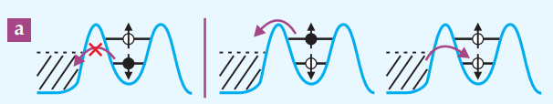
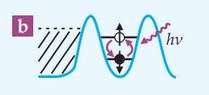
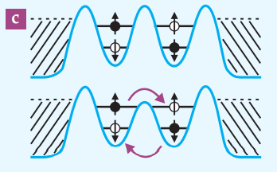
Read Out Initialisation and Manipulation of Spin Qubits
Electrons in the quantum dot tunnels to the reservoir, only if it is in the spin-up state. The current due to this, is detected using the SET.
The electron from the reservoir can only tunnel back to the spin down state. Hence we have initialised our spin qubit in its spin down state.
Manipulation of a single qubit is possible through Rabi oscillations.
By reducing the tunnelling barrier between the two qubits, we can make the electron wavefunctions overlap.

Slide 20
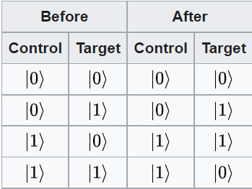
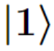
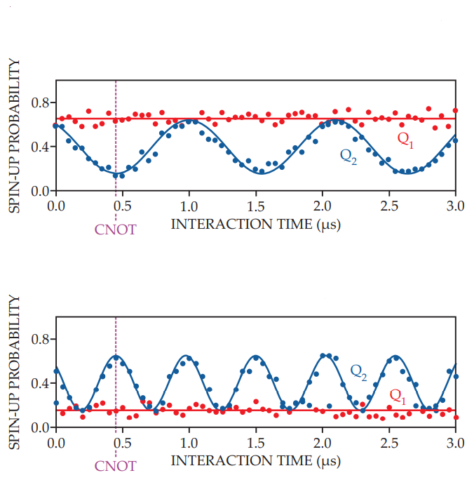
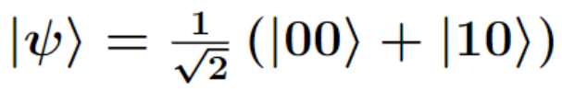
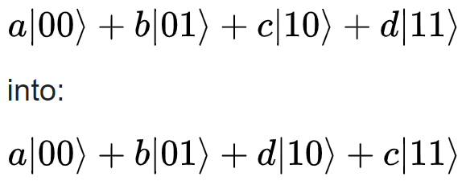
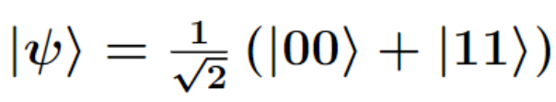
The CNOT Gate
Acts on a two qubit system: Control Qubit and Target Qubit.
It flips the state of target qubit only if the state of Control qubit is
A CNOT gate is achieved at an interaction time of 480 ns.
It is possible to create entangled state using a CNOT state.
CNOT
M. Veldhorst et al., Nature 526, 410 (2015)

Slide 21
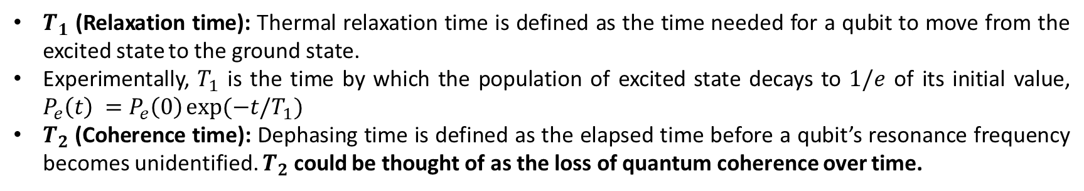
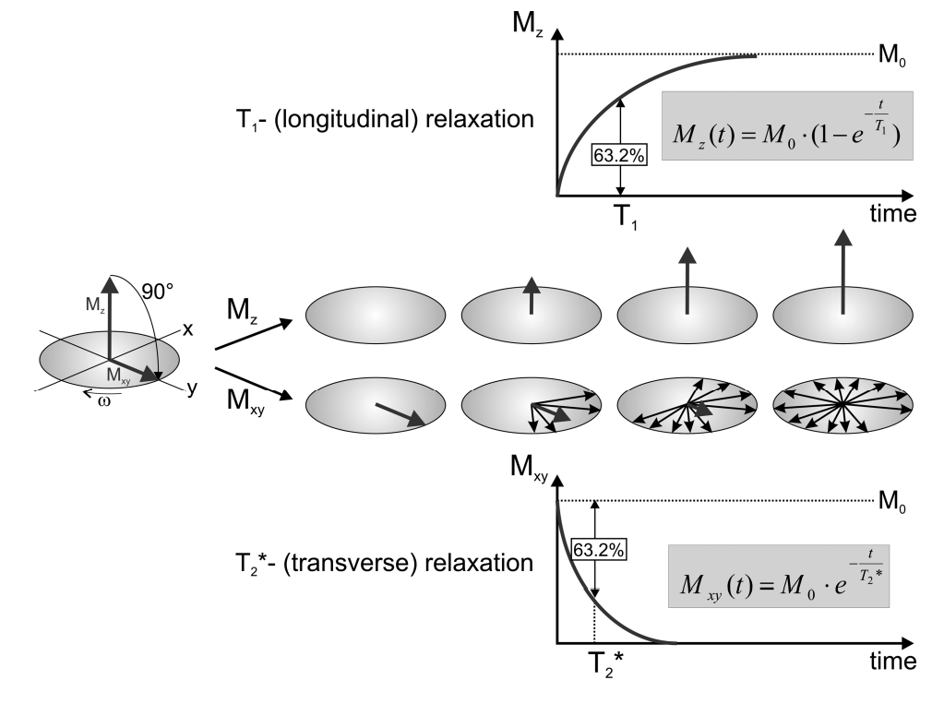
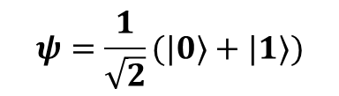
Relaxation and decoherence

Slide 22
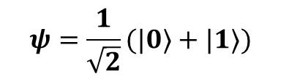
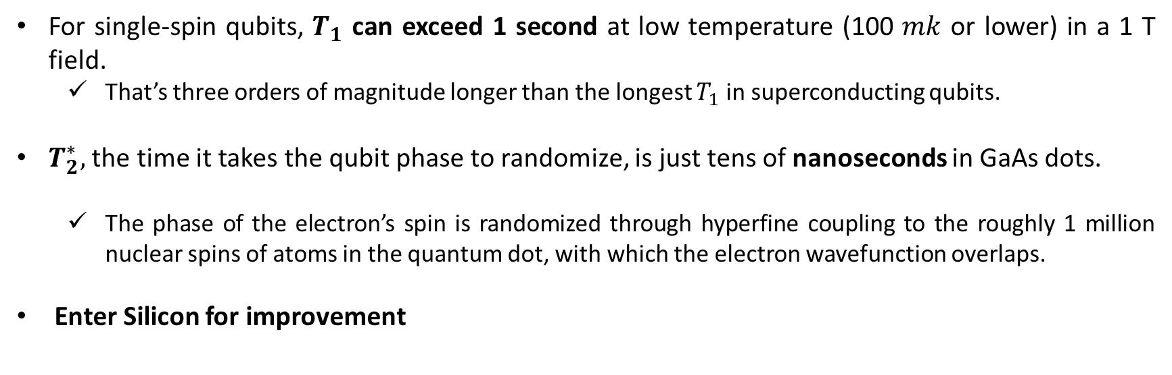
Relaxation and decoherence
Timescales and Improvements

Slide 23
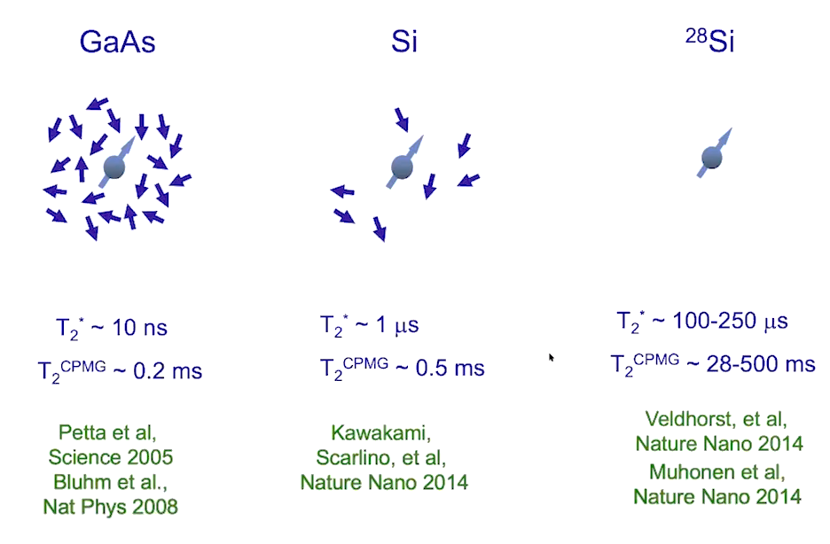
Relaxation and decoherence
Eliminate nuclear spins to boost coherence

Slide 24

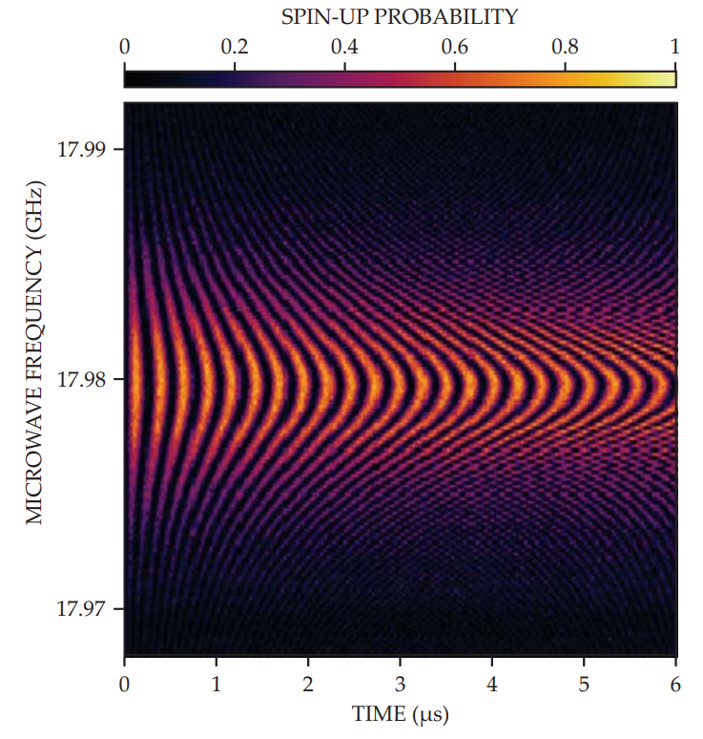
Relaxation and decoherence
FIGURE : DRIVEN EVOLUTION OF A SINGLE QUBIT. When an applied microwave pulse is close to resonance with the spin qubit— that is, with the energy difference between its up and down states (17.98 GHz here)—the qubit undergoes driven rotations, or Rabi oscillation, and the probability of finding it spin-up oscillates as a function of the pulse duration. (Adapted from ref. 10)

Slide 25
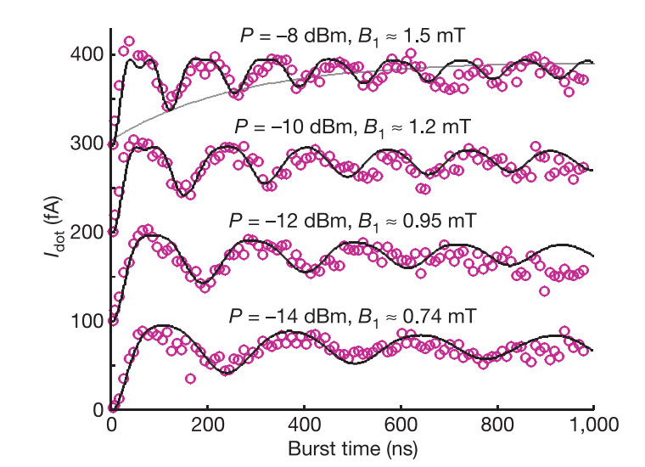
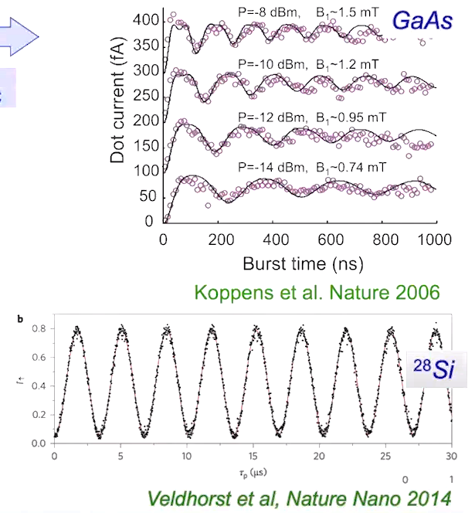
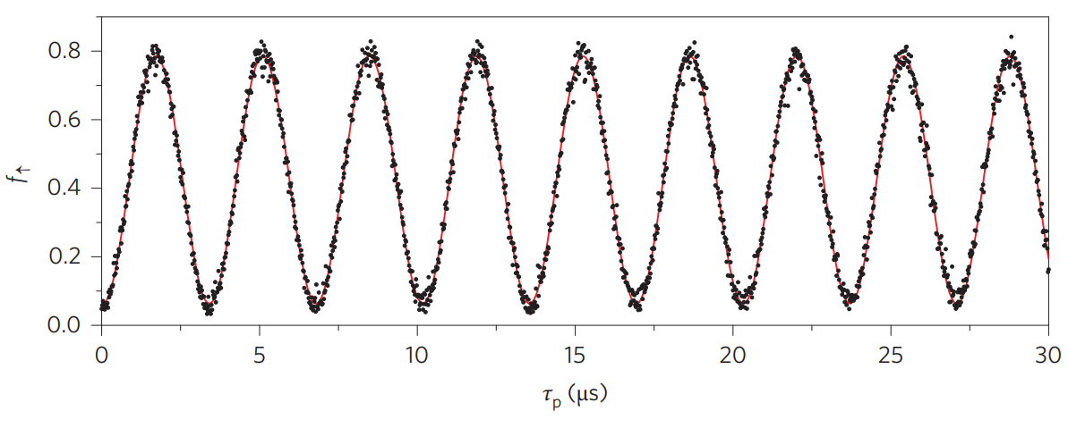
Relaxation and decoherence
Coherent rotations of a single electron spin
GaAs
28Si

Slide 26
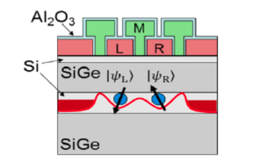
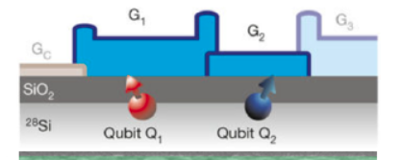
Types of Quantum Dots
SiGe quantum dot
MOS quantum dot

Slide 27

A Two qubit circuit that implements the quantum search algorithm
The algorithm is designed to invert a function f(x) and identify the unique n-bit input value x0 for which f(x0) = 1.

Slide 28


Scaling up: That's the problem!
Flexible architecture of quantum dots to allow manipulation of large qubits at a time
Uniformity of the device fabricated
Wiring issues of qubits when they are scaled to large numbers
Also how to preserve qubit information efficiently when transferring it from one processor/memory to another?

Slide 29





All-optical lithography for industrial-scale Silicon spin quantum dot manufacturing
Silicon's VLSI technology has optical lithography based fabrication methods to precisely make patterns up to 20nm.
They have minimum fabrication defects, and can be used for mass production of qubit chips.
Proposed architecture of Si-quantum dot array that has the flexibility to incorporate up to 10,000 QD arrays.
Zwerver, A.M.J., Krähenmann, T., Watson, T.F. et al. Qubits made by advanced semiconductor manufacturing. Nat Electron 5, 184\[Dash]190 (2022). https://doi.org/10.1038/s41928-022-00727-9

Slide 30

Machine learning to calibrate gate potentials for an efficient spin read-outs
ML schemes have been proposed where the tuning algorithm searches for specific electron transport features in gate-defined quantum dot devices with a gate voltage space of up to eight dimensions.
Starting from the full range of each gate voltage, our machine learning algorithm can tune each device to optimal performance in a median time of under 70 minutes.
The ML predicted sparse matrix of the gate voltages that give
optimal current readout for two qubit quantum dots.
Moon, H., Lennon, D.T., Kirkpatrick, J. et al. Machine learning enables completely automatic tuning of a quantum device faster than human experts. Nat Commun 11, 4161 (2020). https://doi.org/10.1038/s41467-020-17835-9

Slide 31


Use of quantum multiplexers to reduce the wire contacts, and condense information transfer
Garcia-Escartin, Juan Carlos & Chamorro-Posada, Pedro. (2007). Quantum Multiplexing for Quantum Computer Networks.

Slide 32

Achievement of qudits to carry qubit information
Generation of a qudit using entangled photons.
Generates a multi-dimensional photonic state in a quantum cavity
uses the d-dimensional qudit to do manipulations,and
reads out photon count to get the final quantum state.
Sciara, S., Roztocki, P., Fischer, B., Reimer, C., Romero Cortés, L., Munro, W., Moss, D., Cino, A., Caspani, L., Kues, M., Azaña, J. & Morandotti, R. (2021). Scalable and effective multi-level entangled photon states: a promising tool to boost quantum technologies. Nanophotonics, 10(18), 4447-4465. https://doi.org/10.1515/nanoph-2021-0510

Slide 33
Thank You

